Slide 1
CAPSTONE PROJECT
Recreate Classic 2D Game
Ryan Phillips

Slide 2
What are my overall project goals?
- Work with tools available to assign time allocation slots
- Learn and develop an appropriate game engine
- Create and design a sprite and font sheet loading system
- Design animation class for objects within game
- Read, learn and increase knowledge on object collision detection
- Create additional features to make the game interactive

Slide 3
What are my technical achievements so far?
- Extensive background research including reading of articles and design documents
- Successfully mapped functionality for the game
- Created initial plan on where to take the project
- Designed preliminary sketches based on my vision of the game
- Created base display classes for the application

Slide 4
How do I plan to achieve my targets?
- Continue and conclude background research and reading
01
- Manage the project appropriately through planning software
02
- Research further class design for desired functions
03
- Follow time-scale on when do achieve each issue
04

Slide 5
What are my implementation risks?
- Spending too much time on a specific function
- Inappropriate memory allocation when designing game engine
- Uncaught sprite loading errors
- Incorrectly logging issues on Jira

Slide 6
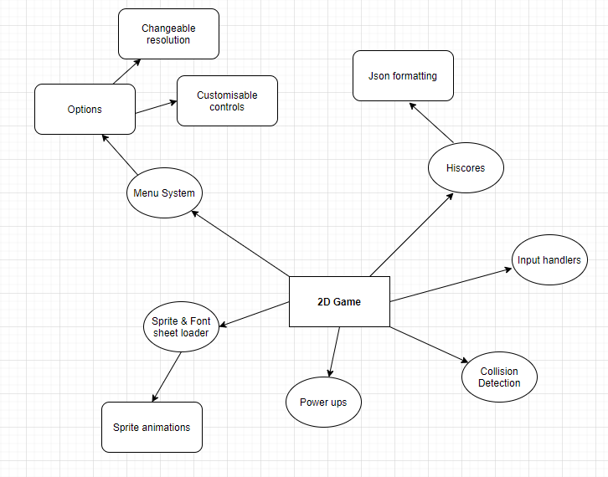
What are my targets for the MVP deliverable?
- Complete menu system fluidly redirecting players
- Functioning sprite loader for player and enemy objects
- Working collision detection between object interactions
- Auto-saving and loading hi-scores
- Appropriate input handlers such as key and mouse user-interaction

Slide 7
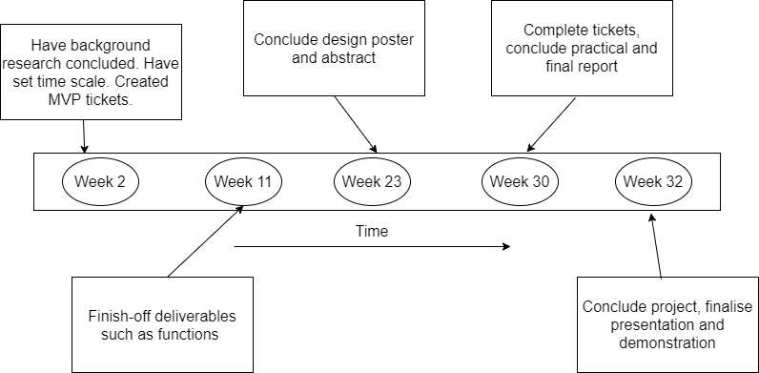
What is my time-scale for the project?

